Slide 1
Mission 4 Functions
A supplemental lesson for AP CSP

Slide 2
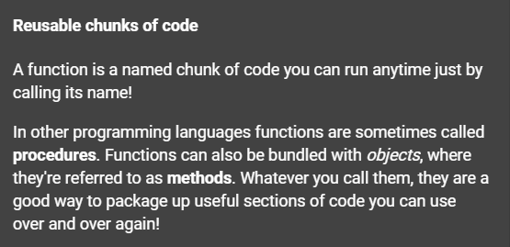
What is a function?
Function: a named set of instructions that accomplishes a task

Slide 3
What is a function?
Function: A named set of instructions that accomplishes a task.
A function is a form of procedural abstraction.
Procedural Abstraction: A technique that breaks down complex tasks into smaller, more manageable procedures.

Slide 4
A function is procedural abstraction
A section or block of code that accomplishes a specific task
Give the block of code a name
Focus on when to use the block of code
Call the function by name when you want to execute the code
The function can be called multiple times in a program

Slide 5
A function is procedural abstraction
A function may be created to
Break down a complex task into smaller, more manageable tasks
Simplify code and make it easier to read and understand
Eliminate duplicate code
Make a section of code adaptable and flexible

Slide 6
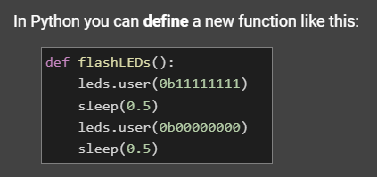
Reminder: Functions in Python

Slide 7
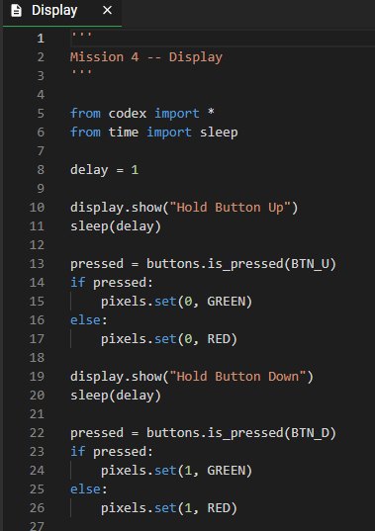
Look at the Display program
Completed in Mission 4
Open it if you don’t already have it in the text editor.
Can you create functions for this program?

Slide 8
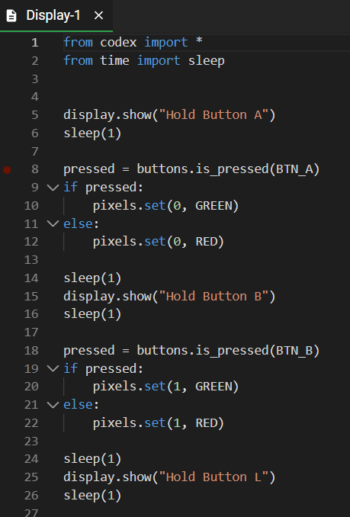
Look at the Display program
Switch to the Sandbox Mode
Save your code with a new name: Display_functions
Use “Save As…”

Slide 9
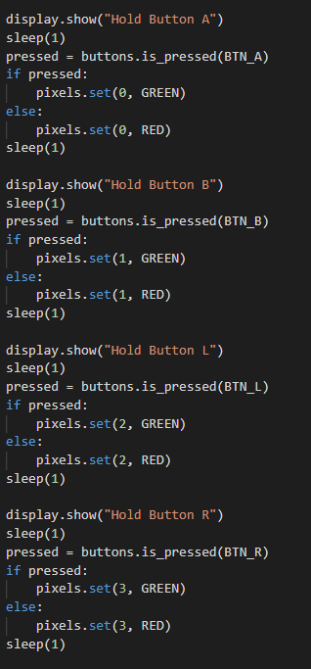
Identify sections of code
Look through your code and find sections that could be functions.
You probably have four sections of your code that can be functions.
Each section is similar, but asks for a different button push and lights a different pixel.

Slide 10
Define a function
Define function for the first button press.
Functions typically are coded near the top of the program, under imports and variables
A function definition ends with a colon (:) – you are creating a block of code
Don’t forget to indent! – the shortcut for this is to highlight the text and press TAB

Slide 11
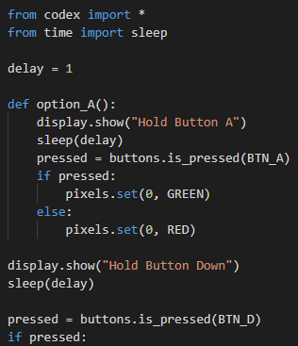
Define a function
Your function may look like this:
Create functions for the other three button presses.
Each function should have a unique and descriptive name.

Slide 12
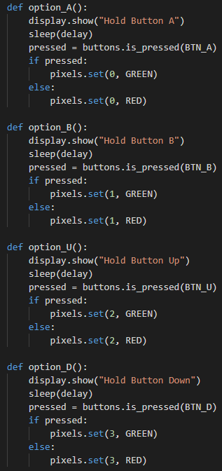
Call a function
Now you have functions for each task (or button press).
Four functions for four tasks.
Is your indenting correct?
Will your code work properly now?
Why or why not?

Slide 13
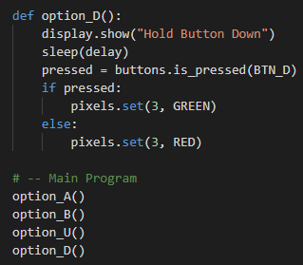
Call a function
All of the code is in functions.
Functions have to be called for their instructions to run.
The great thing about functions is you can call them multiple times and in any order.
Here is one example of calling functions:

Slide 14
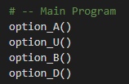
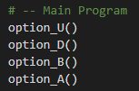
Call a function
Here are more examples. There are many possibilities!
Things to remember:
Function calls go below function definitions.
A function call does not end with a colon (:)
The code in the functions will be run sequentially in the order you call them.

